Slide 1
Passwords

Slide 2
The Good, The Bad and The Ugly
The good
Rely on memory only, no extra hardware/software
Easy to change if compromised
Universally used, requires terminal access only
The bad
Weak passwords, easy to guess by strangers
Personal passwords, easy to guess by friends
Many passwords, reuse or forget/reset
The ugly
Compromised passwords reused at other servers
Compromised passwords give access to more than just user data

Slide 3
Ideal Passwords Are
Strong
Hard to guess by strangers and friends
Look like random character strings
Memorable
Easily and consistently recalled by the user
Have some connection to user memories/values
Diverse
Very different passwords for different sites
Hard to remember many strong passwords, which are uncorrelated

Slide 4
Password Usage
An average user has 25 password accounts
On average 7 actively used, unique passwords
8 passwords typed per day, includes duplicates
An average password is reused at 6 sites
Strong passwords (>60 bits, 9 chars) are reused at 4.48 sites
Weak passwords (<30 bits, 4 chars) are reused at 6 sites
Lots of need for passwords, lots of reuse

Slide 5
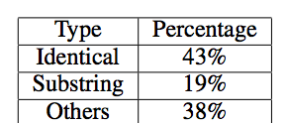
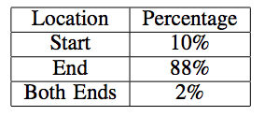
Do People Reuse Passwords?
Password reuse strategies
2-3 chars
Yes! Many passwords are reused with simple strategies Attacker can try a small number of candidates to version a compromised password into the correct one

Slide 6
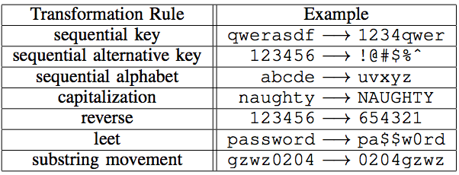
Prominent Transformation Rules
A few trials for the attacker

Slide 7
Does Value of Site Matter?
43% of users considered all accounts to be of equal value
Either reused the same password or different password but same composition strategy
14% thought their news account was of low value
22% thought only bank account was of high value and news and email of low value
Remaining 20% considered all accounts of different value (highest bank or email)

Slide 8
Password Creation Strategies
Usually same approach for all accounts
Link to site or use user-specific words
Then just version
Improves memorability
Capital letters in the beginning, numbers at the end
35% of users relied on memory only to store passwords so memorability was of high concern
Very predictable

Slide 9
Password Creation Strategies
Words chosen based on personal significance
Names of people, pets, locations, dates
Many passwords site-specific
Simple transformation rules that are supposed to make password more secure
Attackers don’t know my pet’s name
Attackers expect me to use my birthday, I will use my friend’s birthday
I don’t have this info on Facebook
Hard-to-spell words, passphrases from books
Don’t work against automated attacks
Users don’t expect automated attacks

Slide 10
Possible Improvements
Help users choose strong passwords (Telepathwords, password strength meters)
Educate users about good choosing strategies (start with passphrase, replace some characters)
Come up with a different way to do passwords
Draw them
Pick favorite picture
Security questions
Use memories of personal events

Slide 11
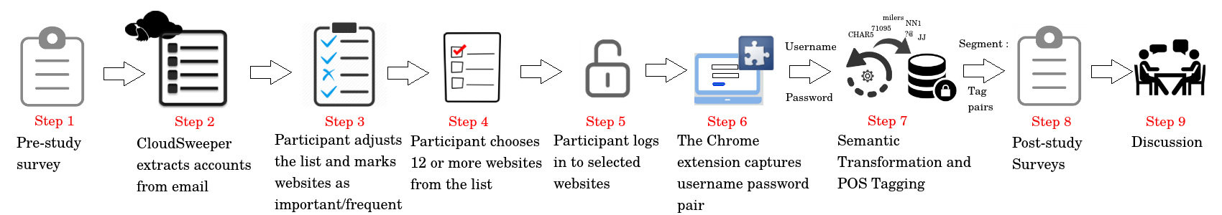
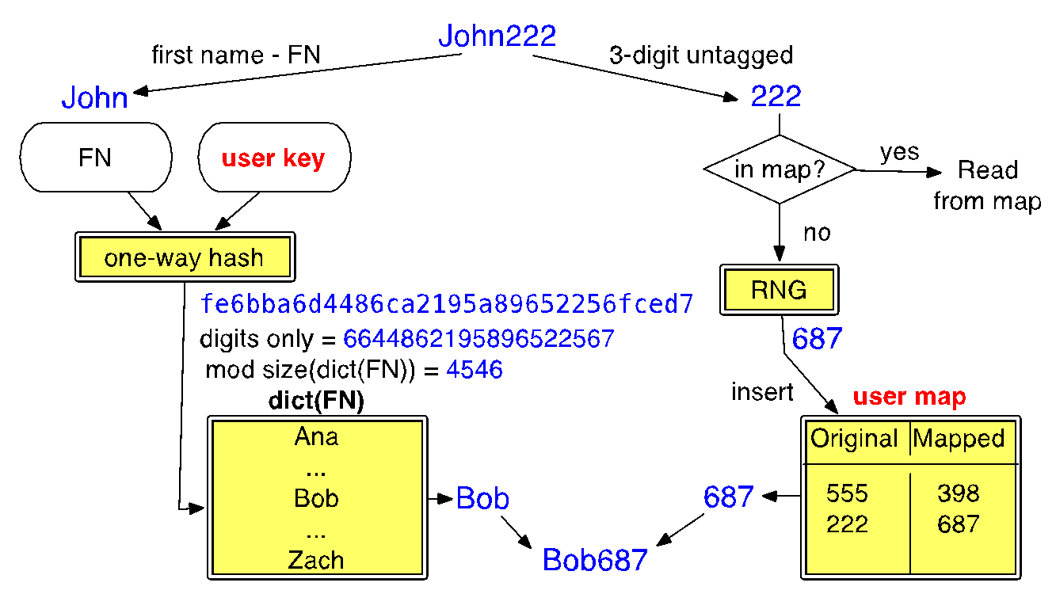
Study Methodology

Slide 12
Findings
Users do not know what they are doing
Bounded rationality – users do not make rational decisions but are bounded by time, cognitive limitations, problem complexity
Users underestimate the number of accounts they have: 15 vs 80
Narrate more rational reuse strategies, not supported by password analysis, e.g., “I do not reuse” or “I reuse only between non-important accounts”
Narrate different password composition policies, e.g., “I use random letters”, not supported by password analysis

Slide 13
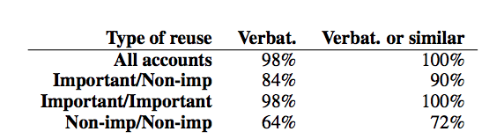
Findings
Reuse is rampant and indiscriminate
Users value memorability
44% knowingly reuse because of memorability
Users rely on memorability
Passwords of those who use managers are not stronger or more diverse
Users underestimate risk
76% assume an online guessing attack
18% do not understand password reuse attacks

Slide 14
Recommendations
Tools that keep track of user password habits
Easy to integrate this with password managers
Identify problematic cases of reuse (important accounts)
Identify rarely-used accounts and help users change their passwords to random
Produce summaries of password hygiene
Help users create stronger passwords
Help users create strategies that associate passwords with servers

Slide 15
Mnemonic Passphrase (MNPass)*
System-Generated Passphrases (SysPass): Secure but less memorable. Also, does not scale as number of accounts increase
User-Chosen Passphrases (Upass): Memorable but less secure
Our Goal (MNPass): explore Memorable, Secure, Diverse, and Usable Passphrase generation
We hypothesize people are creative enough but just not trained to come up with good passphrases
Increase Memorability: By letting users choose their own instead system assigns and also provide the first letter mnemonic
Increase Security: By carefully generating mnemonic chars (MNChars) constraints, where each word user chooses should contain a letter from MNchars in order
*”Improving Recall and Security of Passphrases through Use of Mnemonics”
Simon Woo, Jelena Mirkovic, Proc of Passwords Conference 2016

Slide 16
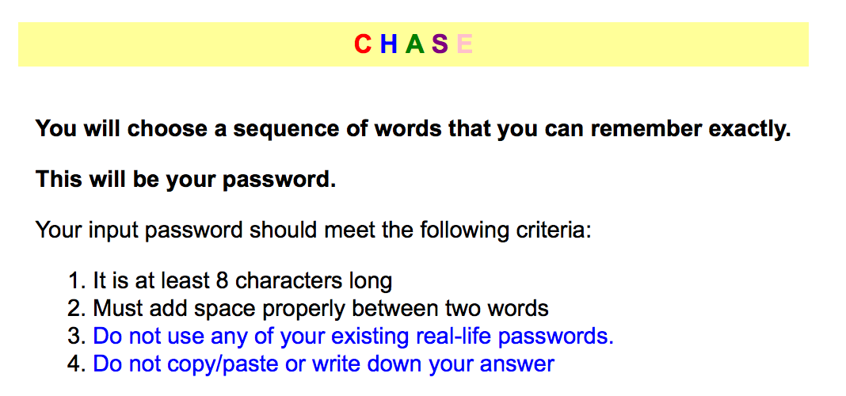
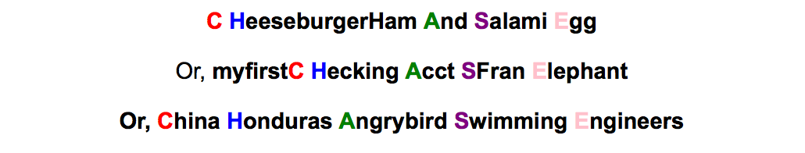
MNPass Example
Study Link
Examples

Slide 17
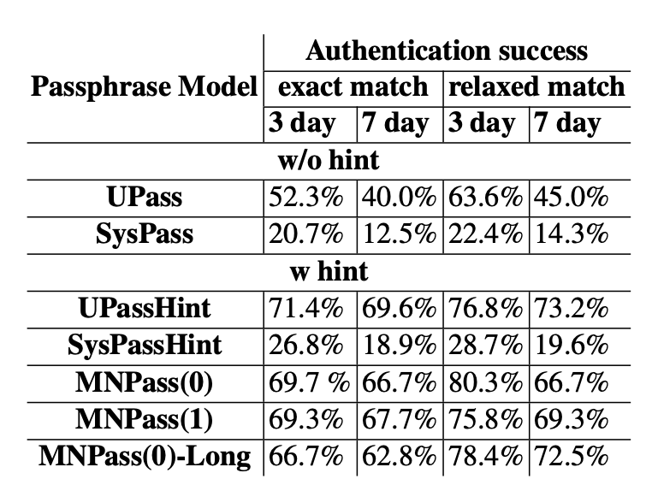
Recall is comparable to UPass

Slide 18
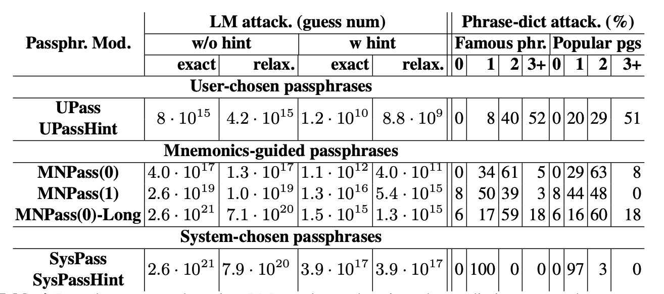
Security is comparable to SysPass

Slide 19
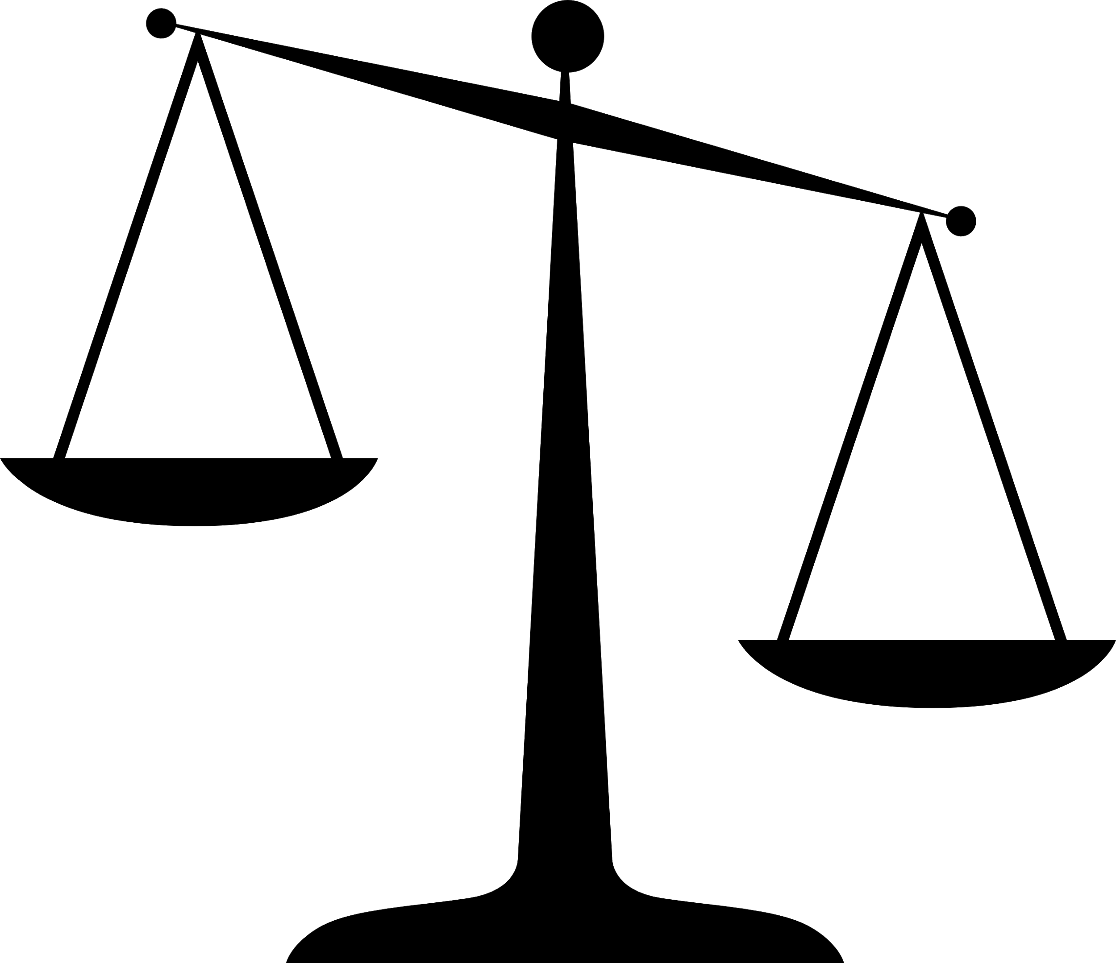
Life-Experience Passwords (LEPs)*
Strong passwords are easily forgotten
Weak passwords are easily broken
Users reuse passwords at different sites
This holds for non-textual passwords too, plus they are more difficult to use
memorability
guessability
* “Life-Experience Passwords (LEPs),” Simon Woo, Elsi Keiser, Ron Artstein, Jelena Mirkovic, Proceedings of ACSAC, 2016

Slide 20
Life-experience Passwords
Use memories from a user’s past
Collect facts – time, locations, people, activities, conversations
No preferences, no opinions
Turn this into Q & A pairs
Questions become prompts
Answers become LEP

Slide 21
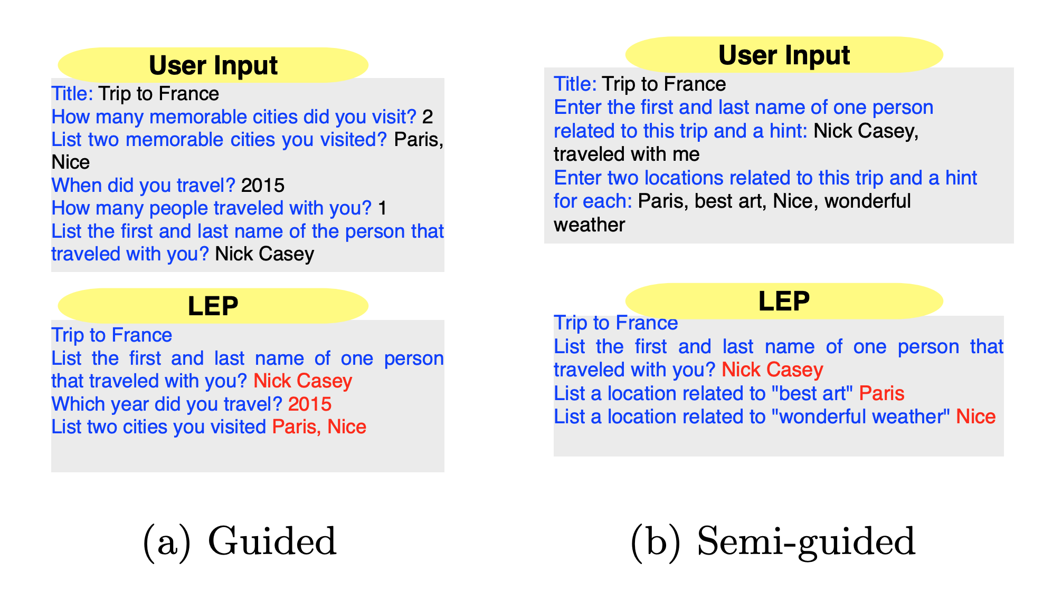
Life-experience Passwords

Slide 22
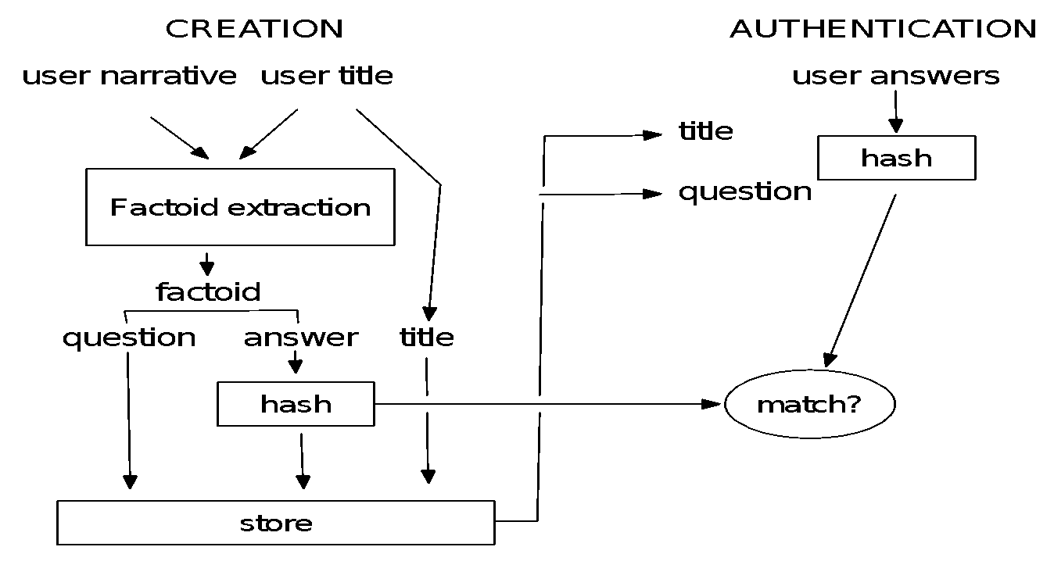
Life-experience Passwords

Slide 23
Challenges
How to collect memories, needs to be user-friendly
“Tell me a story” vs Q & A
How to mine for useful data
Using natural language processing, hard in general
How to detect weak facts
E.g. relationships vs names, empty stories
How to avoid use of sensitive info in LEPs
How to deal with synonyms, misspellings, etc.
How to store these passwords using one-way hashes

Slide 24
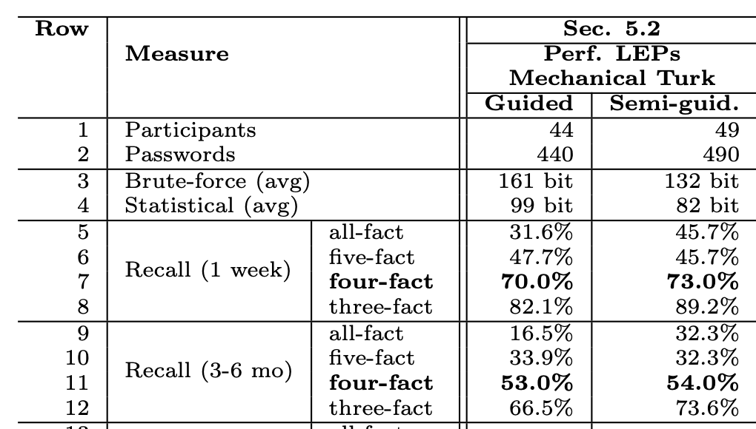
LEPs Are Strong and Memorable
Comparable password strength is 53 bit and recall is around 26% and 9%

Slide 25
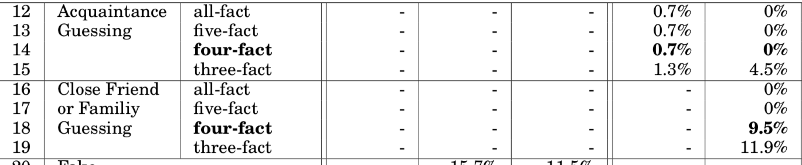
LEPs Are Hard to Guess
Comparable security questions are guessed at 17-25%

Slide 26
LEPs Are Diverse
Less than 0.5% are the same and up to 15% are similar
Attacker must guess 34-48 bits to authenticate
Around 6% of OPs are the same and up to 32% are similar
Attacker must guess 37 bits to authenticate

Slide 27
Issues
LEPs took 5x longer to create and authenticate
How do we store LEPs?
Hash per answer
Easy to break by guessing most likely answers first
Hash per LEP
User must recall all facts
Several hashes of strong combinations of facts
No feedback to user what they missed

